Slide 1
DFD Rules and Guidelines
Yong Choi
BPA
CSUB

Slide 2
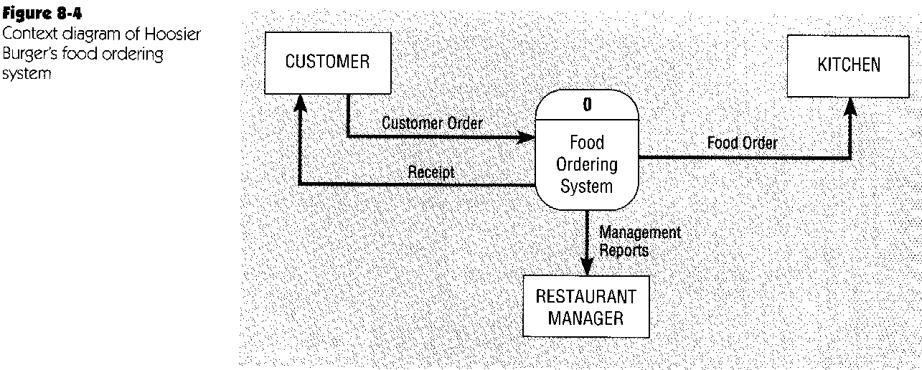
DFD example - Hoosier Burger’s food ordering system I
* One process (level 0 - the whole system)
* No data store

Slide 3
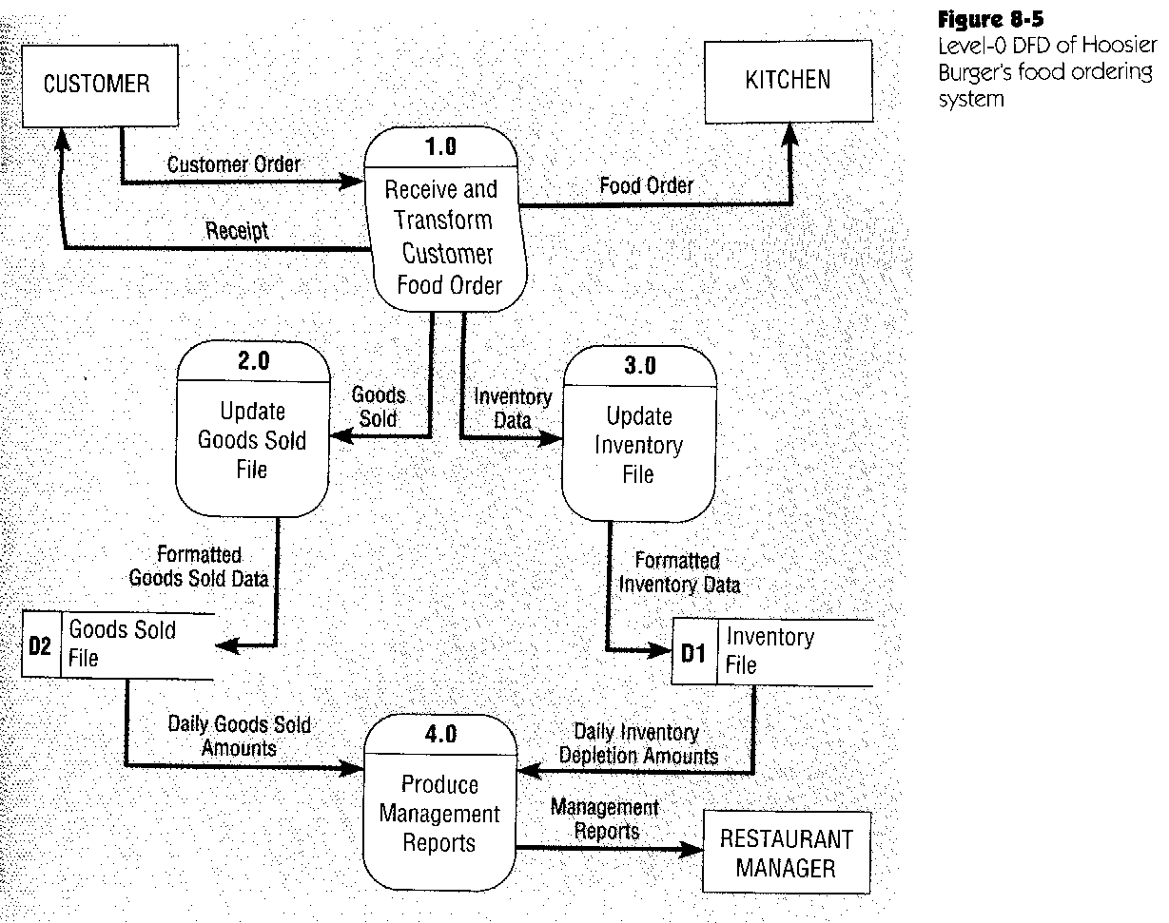
DFD example - Hoosier Burger’s food ordering system II
Represent the major processes & data stores of the level-0 whole-system process of the context diagram
Coupled processes
Decoupled (independent) processes

Slide 4
DFD guidelines & rules I
Starting with context diagram, DFDs are refined and decomposed from level to level, with more detail at each lower level
Process’s input & output are different
Unique descriptive names to all objects
But the same objects (and names) may appear at various levels
To minimize clutter a data store (or even dataflow) may be repeated even on the same diagram
Process names usually start with a verb

Slide 5
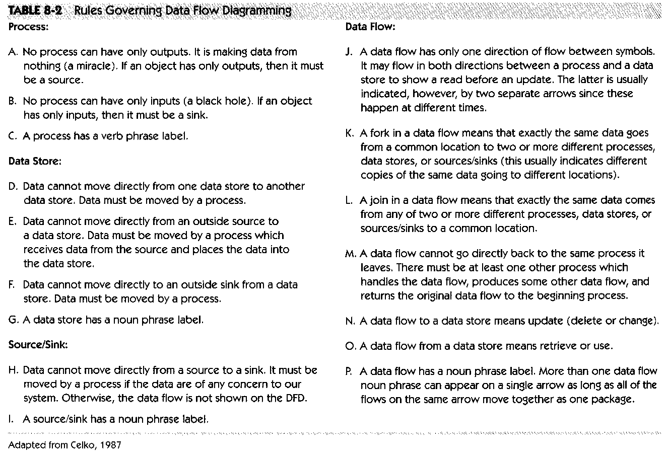
DFD guidelines & rules II

Slide 6
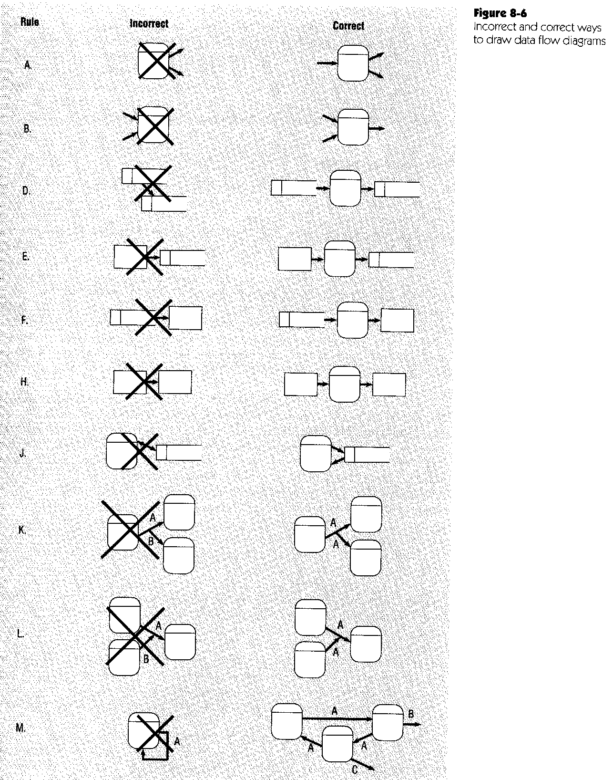
DFD guidelines & rules III

Slide 7
DFD (functional) decomposition
An iterative hierarchical process of refining the details of a system, creating a set of charts at lower and lower levels, in which a process at a certain level is explained on the next level in greater detail
Primitive DFD: the lowest level DFD, where no process can (or it is useful to) be broken any further

Slide 8
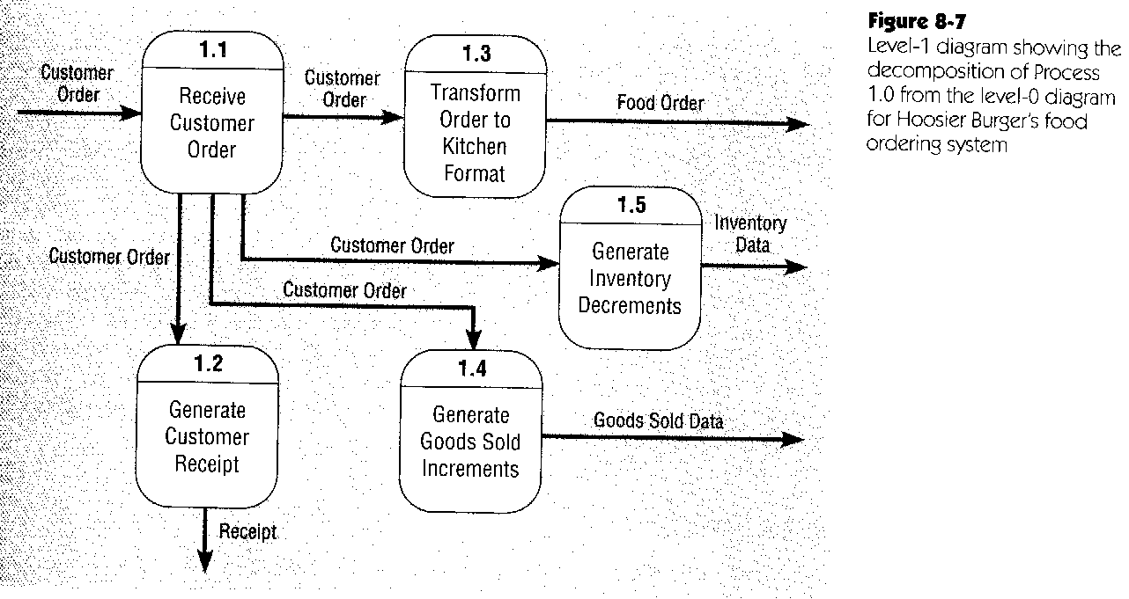
DFD example - Hoosier Burger’s food ordering system III
* Hierarchical notation
* No sources or sinks

Slide 9
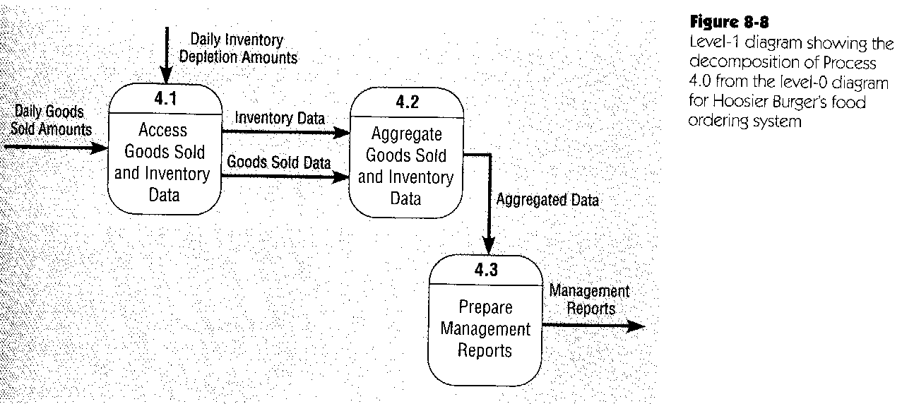
DFD example - Hoosier Burger’s food ordering system IV
* No need to decompose processes 2.0 & 3.0 (singular logical action)

Slide 10
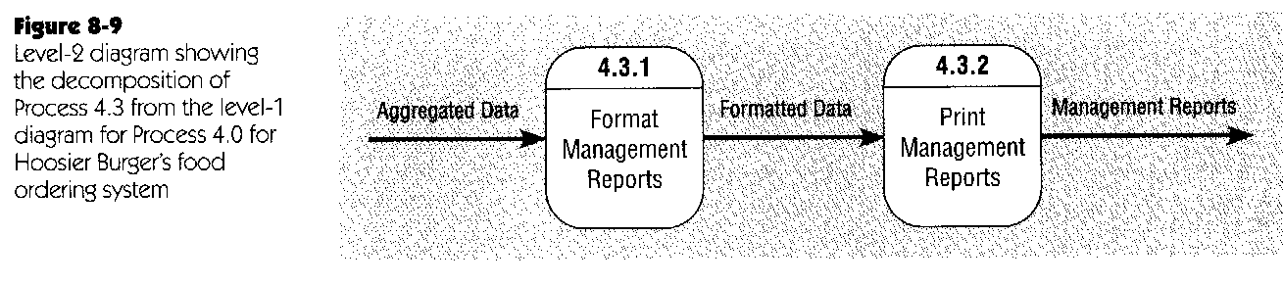
DFD example - Hoosier Burger’s food ordering system V
Similar decomposition of other level-1 processes can be done, as need dictates

Slide 11
DFD balancing I
Conservation of inputs and outputs when a process is decomposed
A decomposed process must have the same inputs and outputs as the non-decomposed process from which it was derived

Slide 12
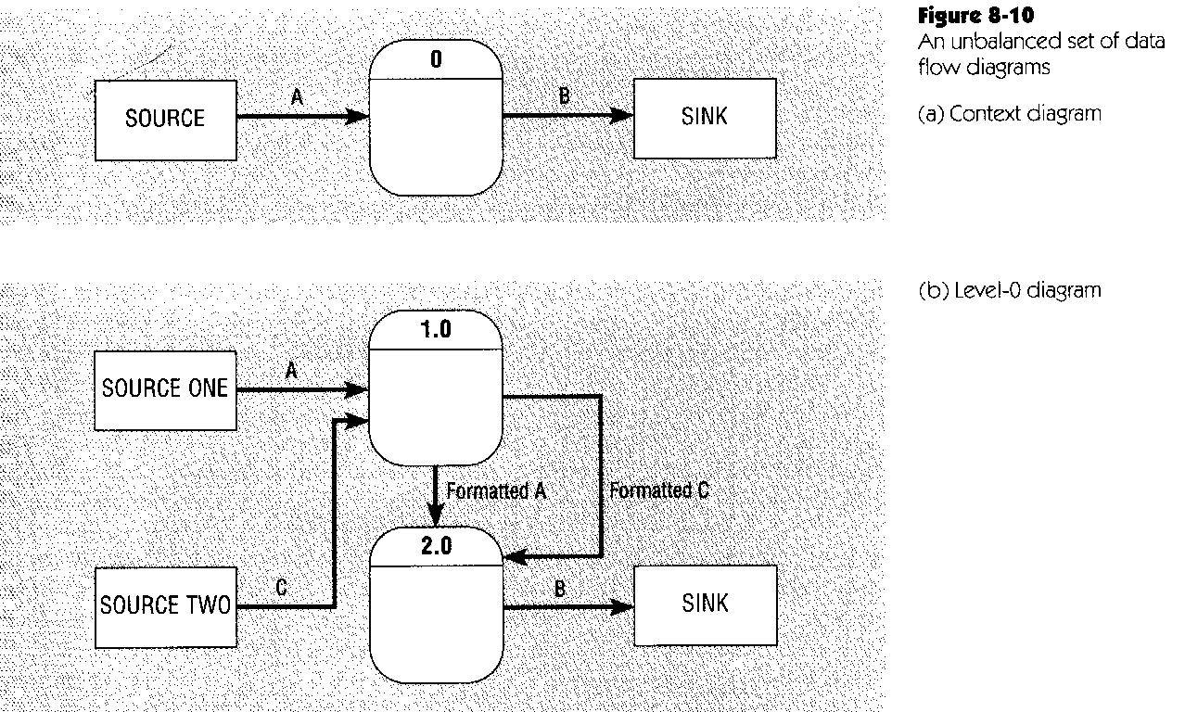
DFD balancing II
An unbalanced example:

Slide 13
DFD balancing III
But a composite dataflow may be split ...
e.g., “payments and coupons” leading into process 1.0 may be split into:
“payments” leading into 1.1
“coupons” leading into 1.2
But all data must be conserved between levels

Slide 14
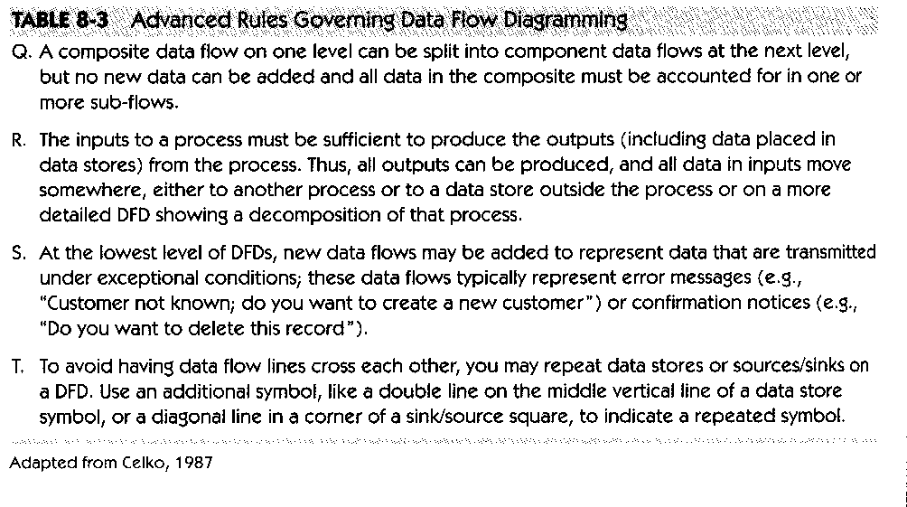
DFD guidelines & rules IV

Slide 15
DFD types I
Current physical DFD
Process labels include location and technology
Names of people
Names of computer and other physical systems
Same with data stores and dataflows

Slide 16
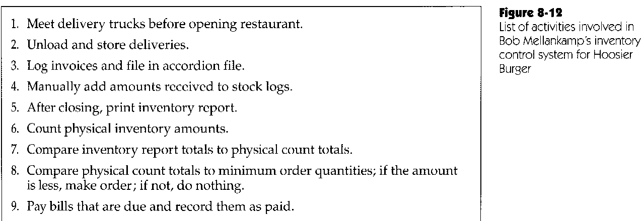
DFD types IIa

Slide 17
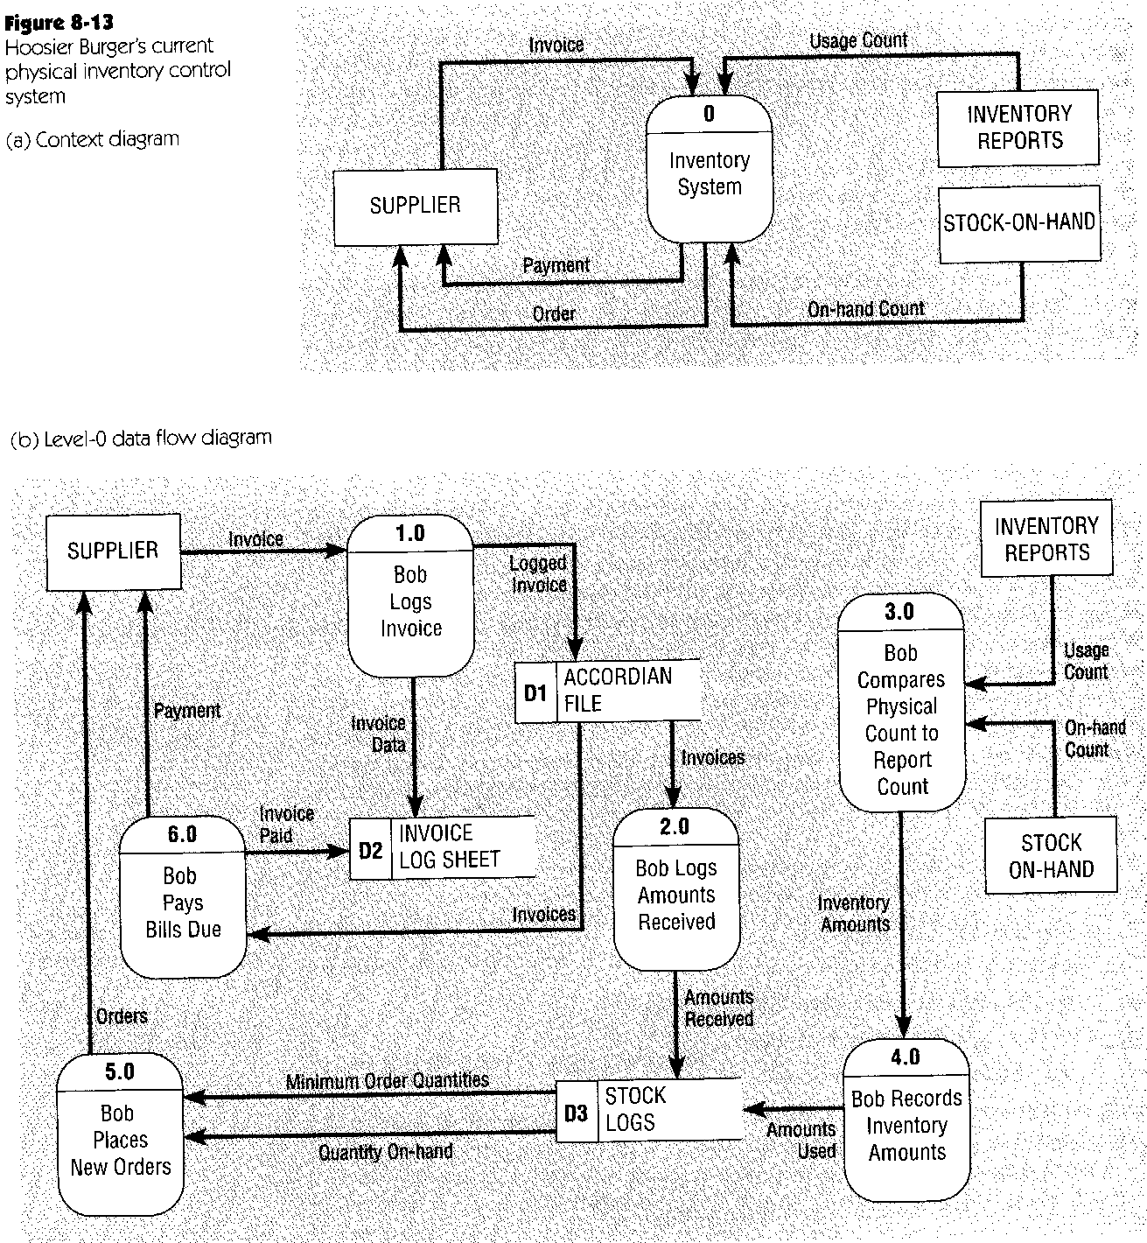
DFD types IIb

Slide 18
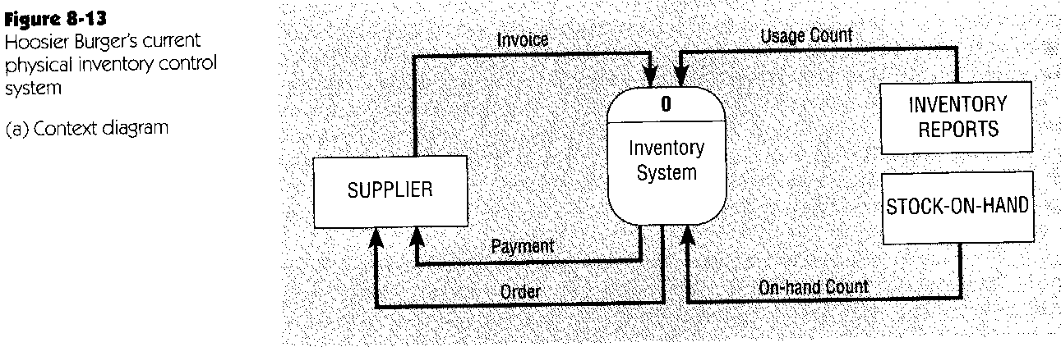
DFD types IIc

Slide 19
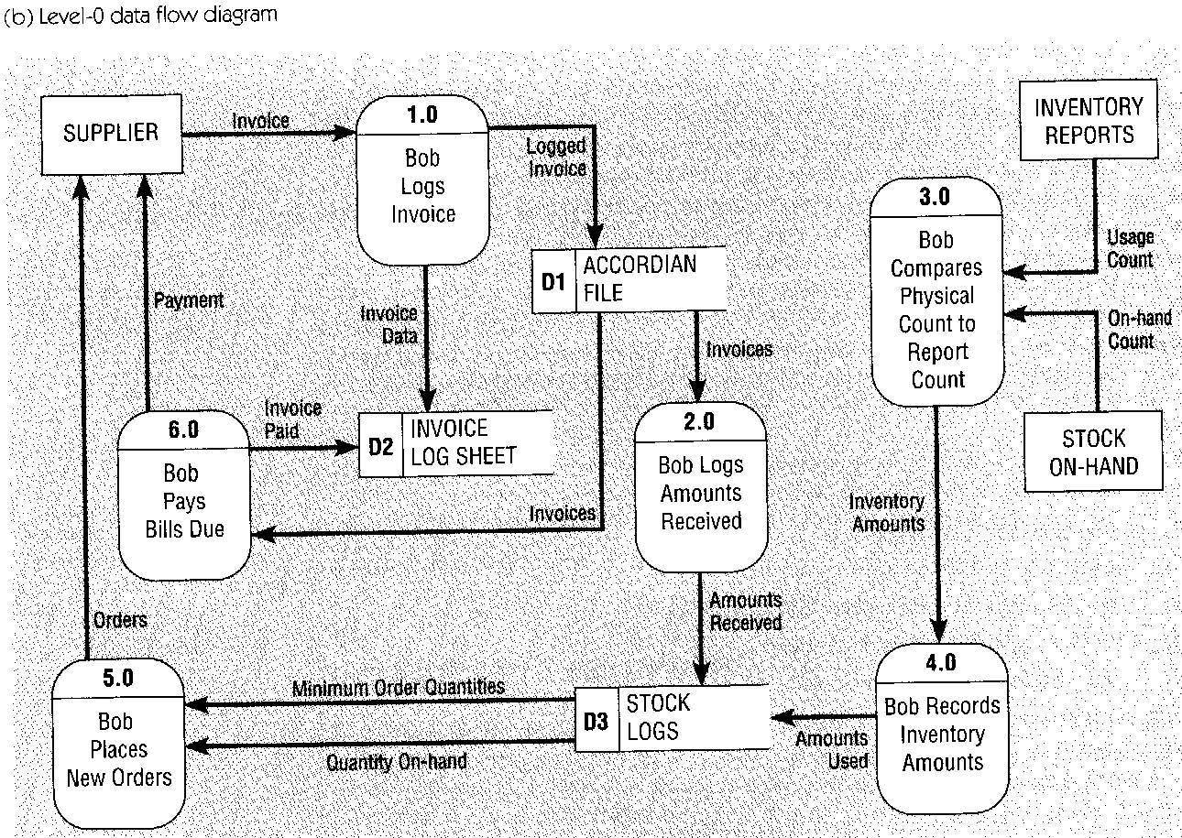
DFD types IId

Slide 20
DFD types III
Current logical DFD
Physical characteristics are removed
Names of people, departments, and other locations
Names of technological physical devices & facilities

Slide 21
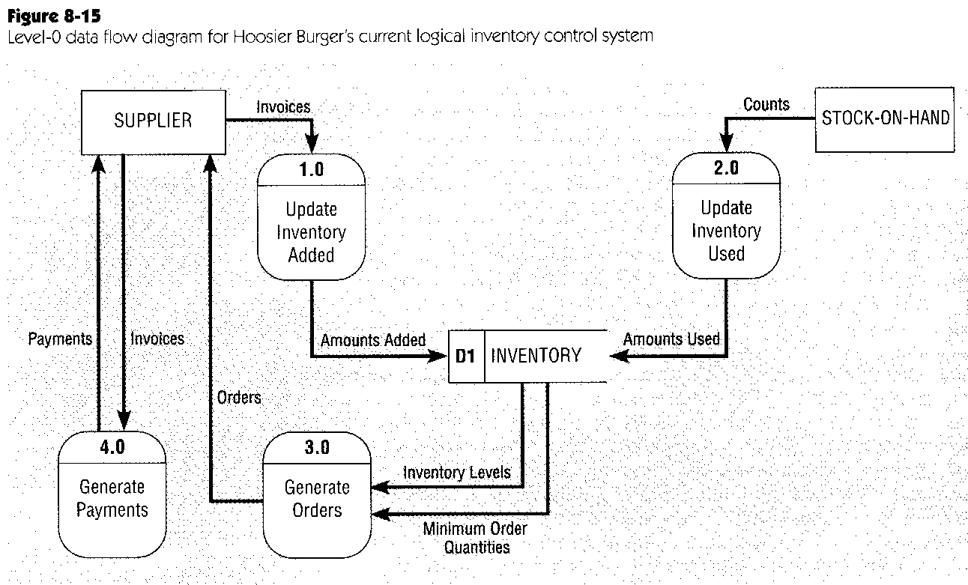
DFD types IV

Slide 22
DFD types V
New logical DFD
Derived from current logical DFD
Removed entities
Expanded and added entities
Flows and processes reorganized
Order modified
May remain identical to current logical DFD

Slide 23
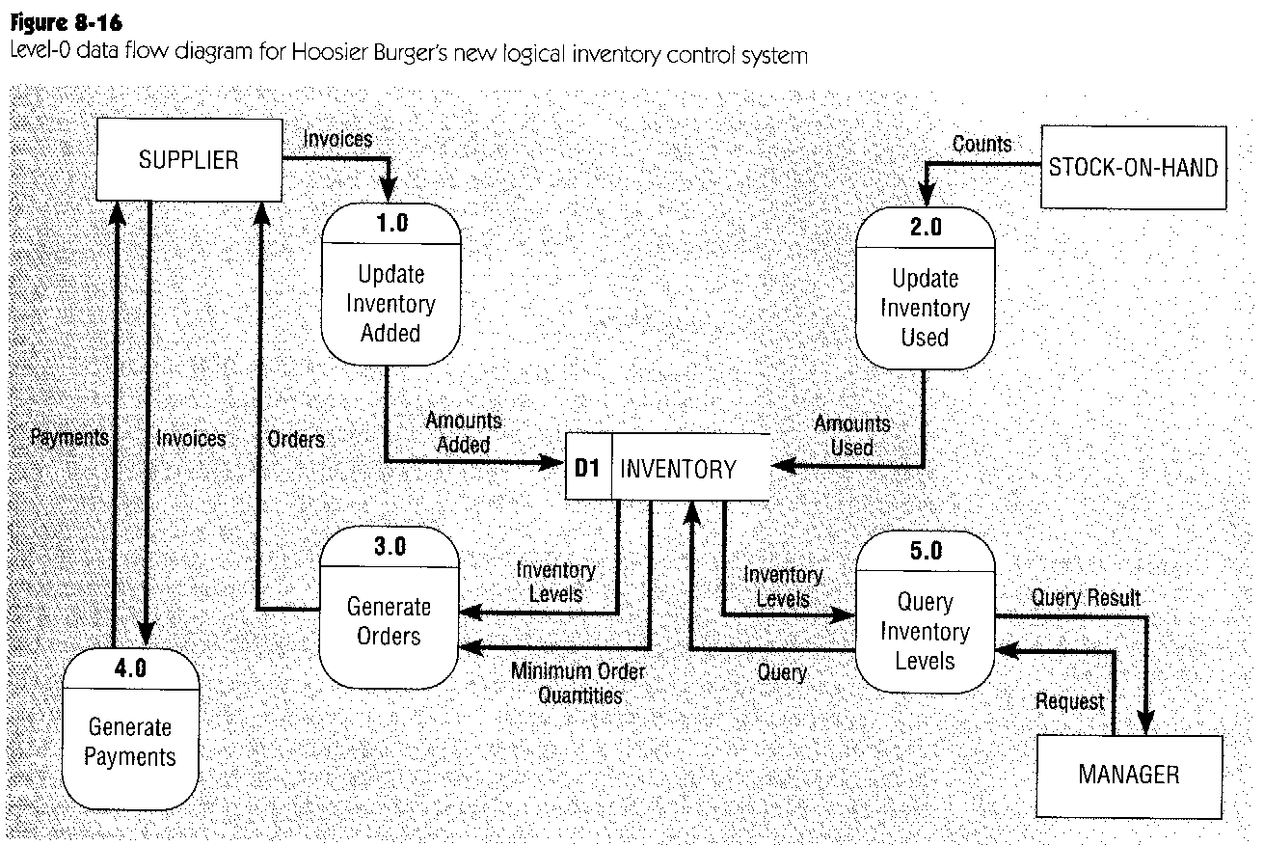
DFD types VI
New Process

Slide 24
DFD types VII
New physical DFD
The physical implementation of the new logical DFD
Names and locations added
Technologies and devices identified
Identification of automated procedures

Slide 25
DFD guidelines & rules V
Completeness: include and fully describe all necessary components of a system
Consistency: Assure that all information at one level is also contained on the next/former level
Iterative development process
Timing
Cannot be represented by DFD
Will be represented by state-transition diagram
Assume system operates indefinitely
Decide about the primitive (lowest level) diagrams

